Slide 1
Laparoscopic Sleeve Gastrectomy (LSG) versus Robotic Sleeve Gastrectomy (RSG): studio comparativo degli outcomes perioperatori
Antonio franzese, md
Universita’ degli studi di napoli federico II
Scuola di specializzazione in chirurgia generale
U.O.C. Chirurgia generale ad indirizzo bariatrico endocrino-metabolico e senologia, prof. M. musella

Slide 2
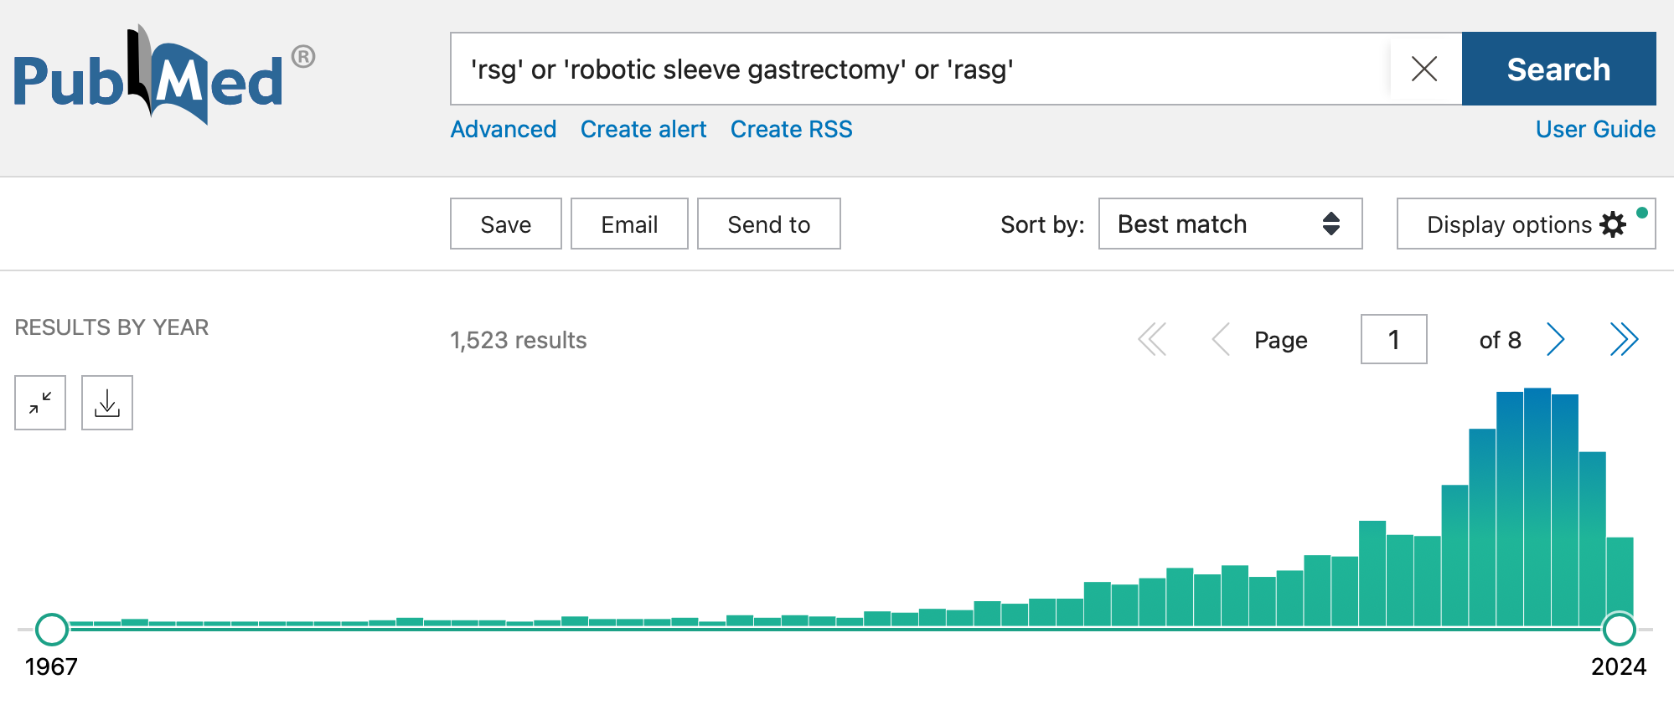
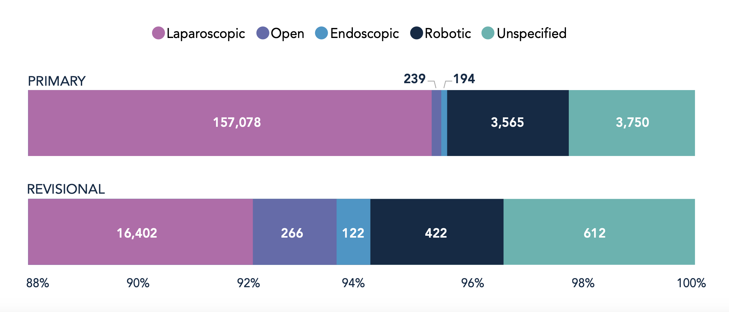
Background

Slide 3
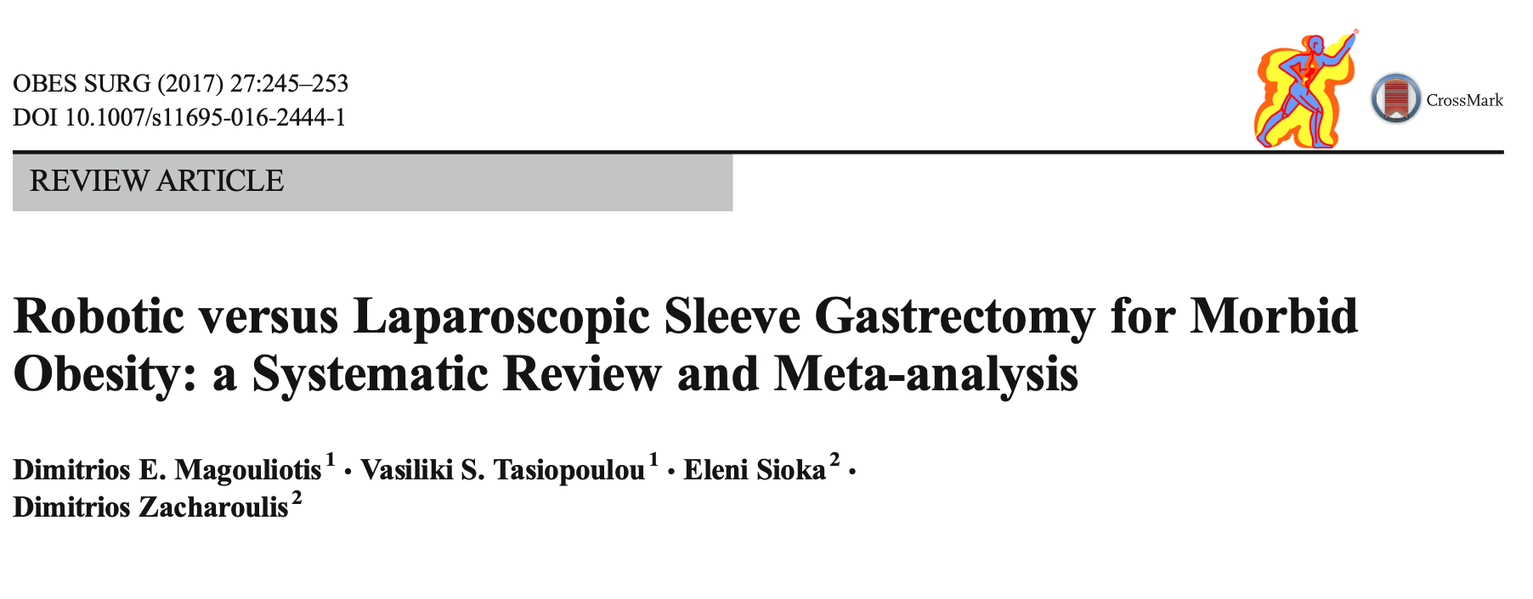
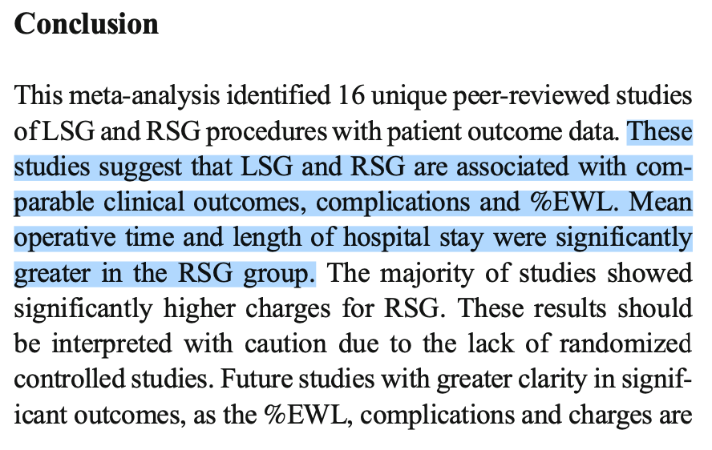
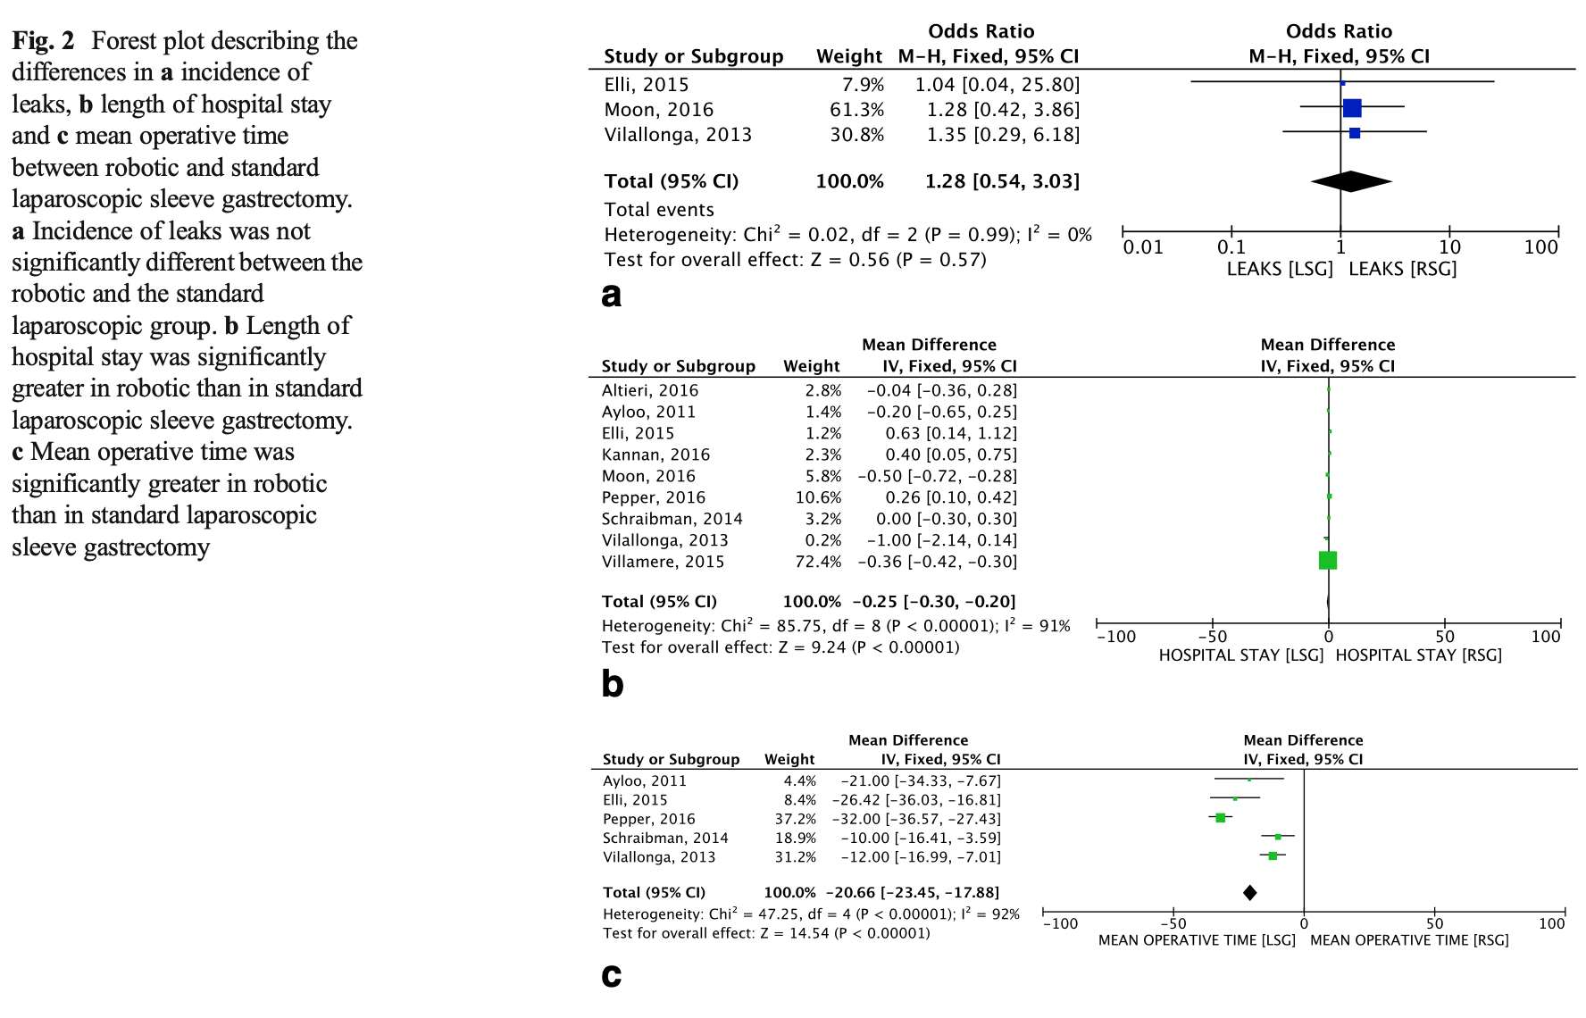
Background

Slide 4
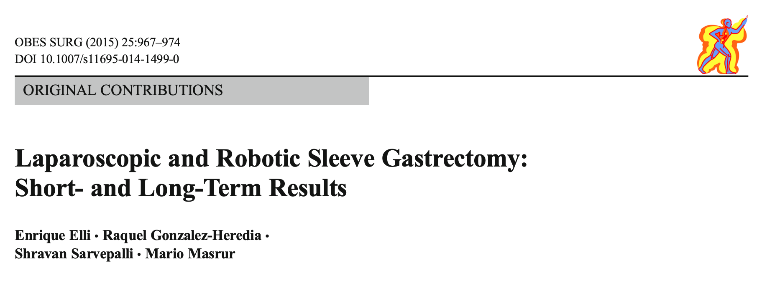
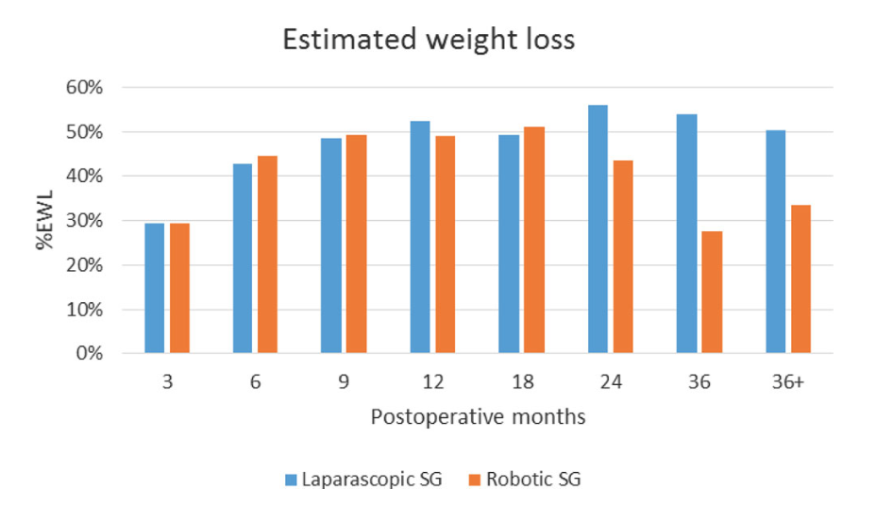
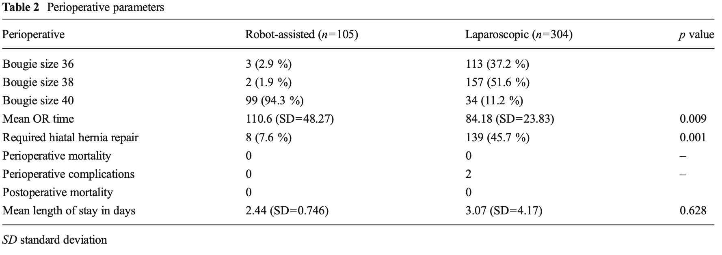
Background

Slide 5
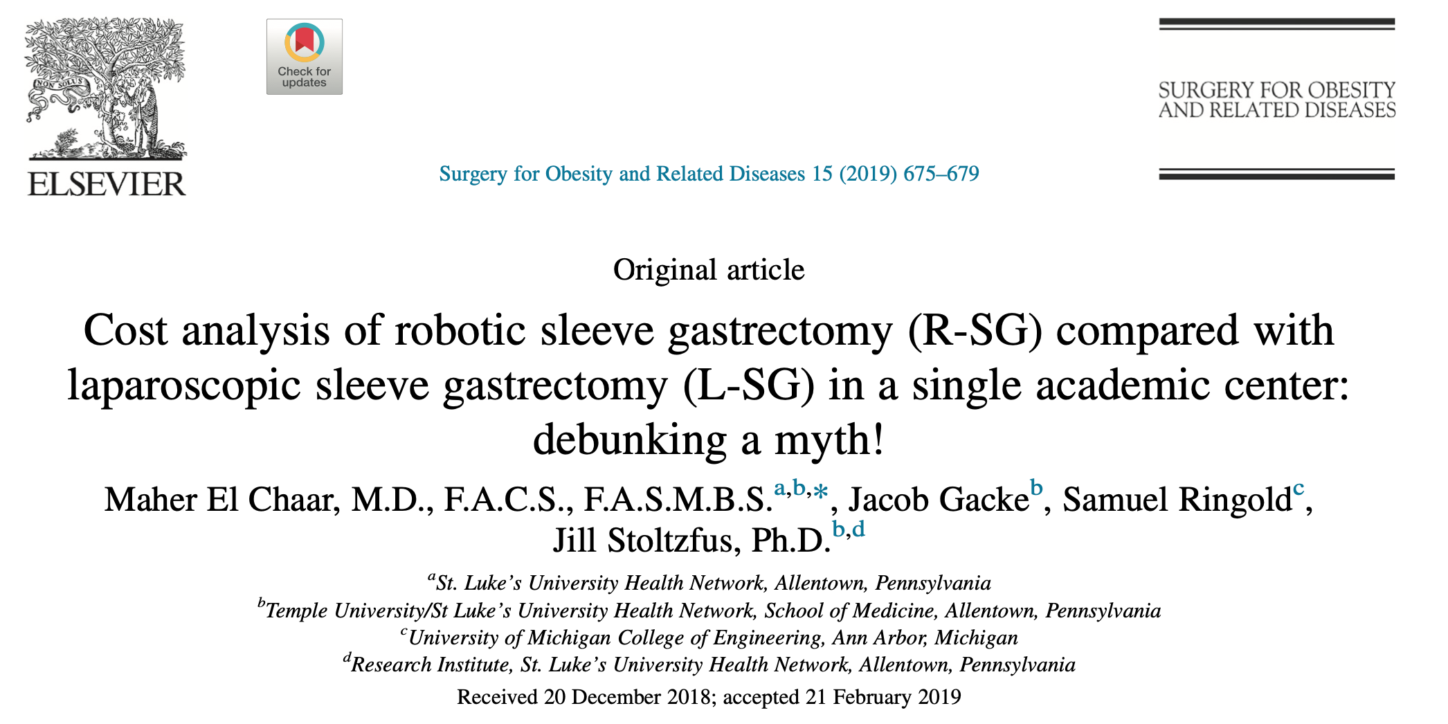
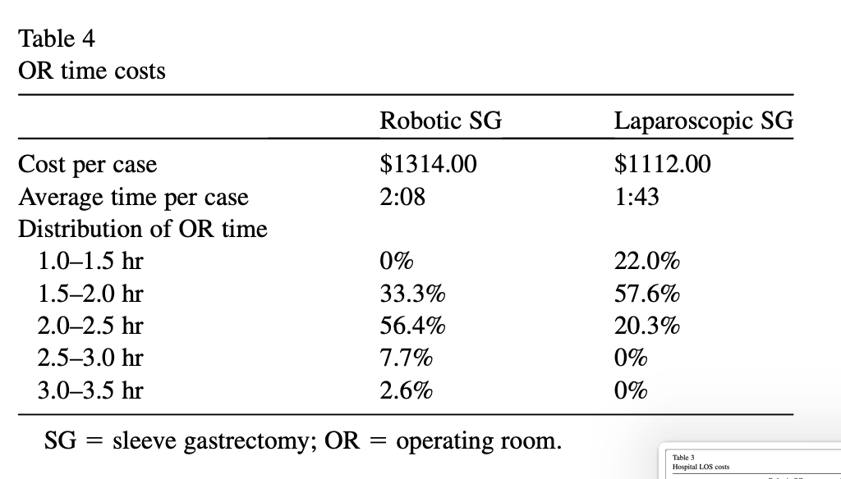
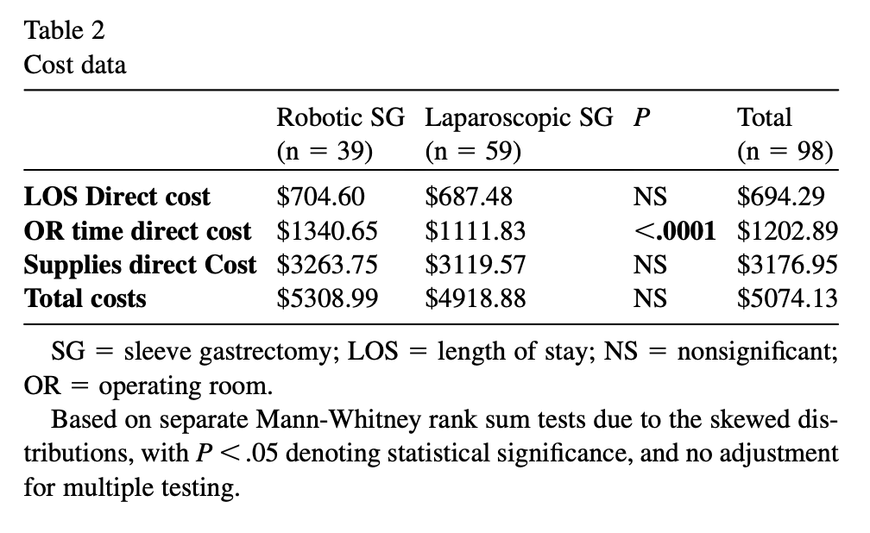
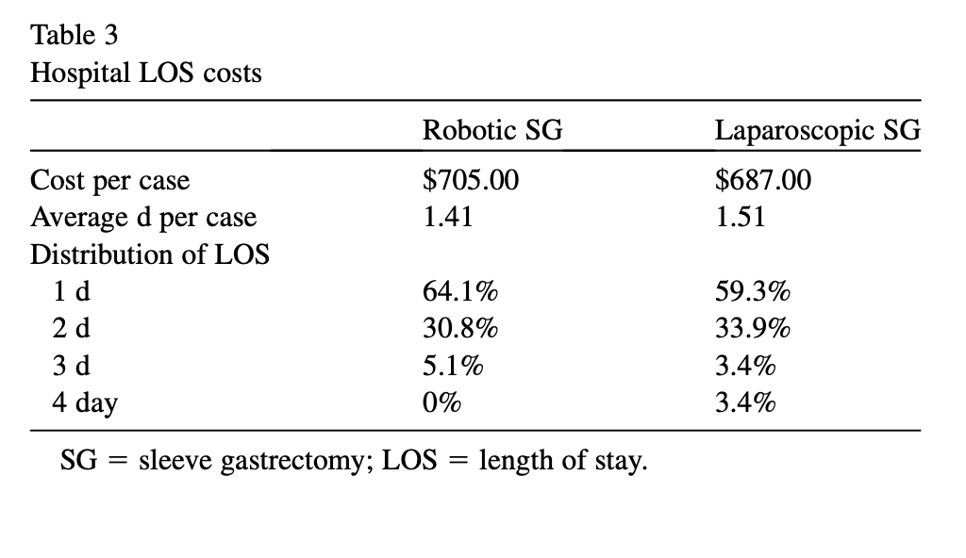
Where is the problem?
The overall cost for R-SG and L-SG was not sta- tistically different (mean total cost for R-SG and L-SG was $5308.99 and $4918.88, respectively). Operating time cost was significantly higher for R-SG compared with L-SG ($1340 versus $112 for R-SG and L-SG, respectively). R-SG had a shorter length of stay compared with L-SG (1.4 versus 1.5 d, respectively).

Slide 6
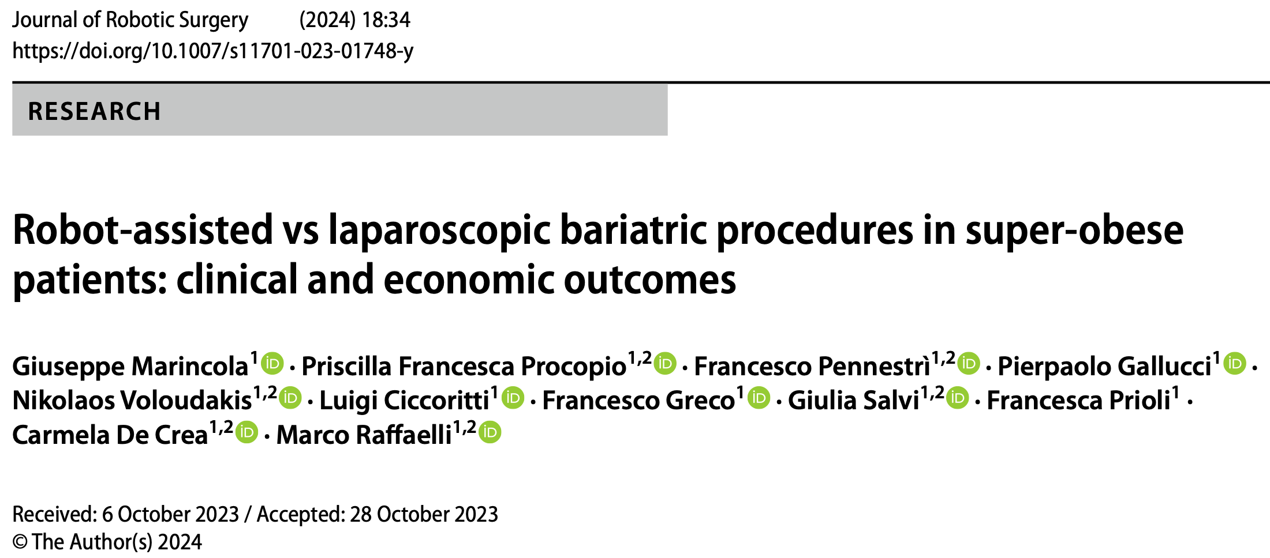
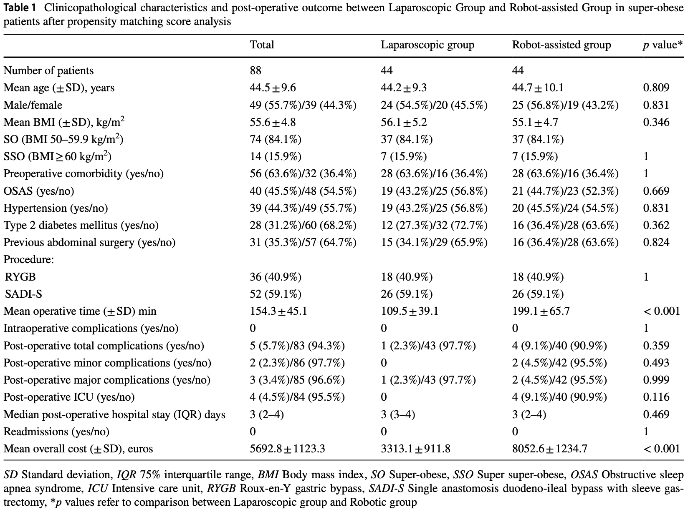
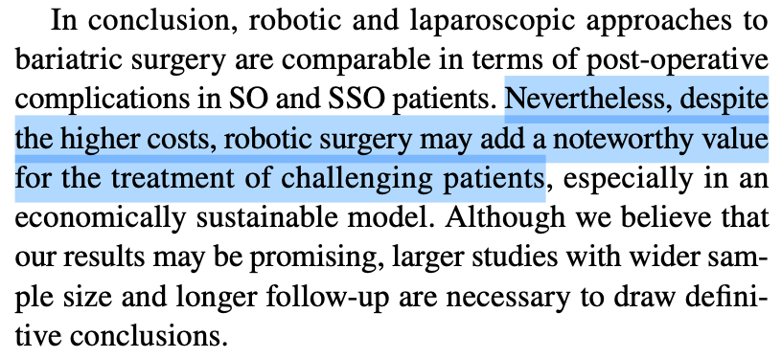
Where is the problem?

Slide 7
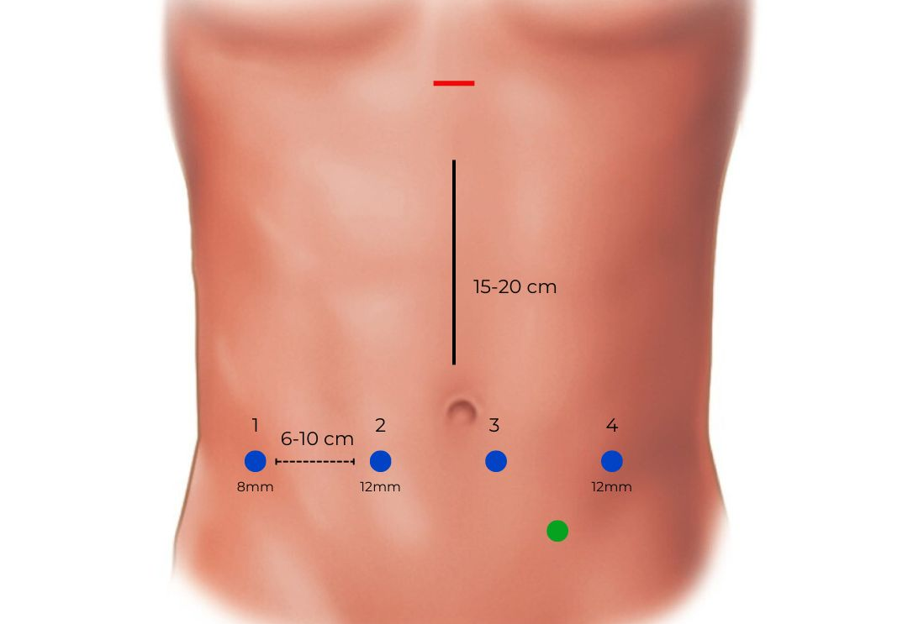
RSG: How we do it
Trocars placement and docking
Targeting
Dissection of the greater curvature
36FR Bougie
Vertical gastrectomy
Methylene-blue test
Abdominal Drain

Slide 8
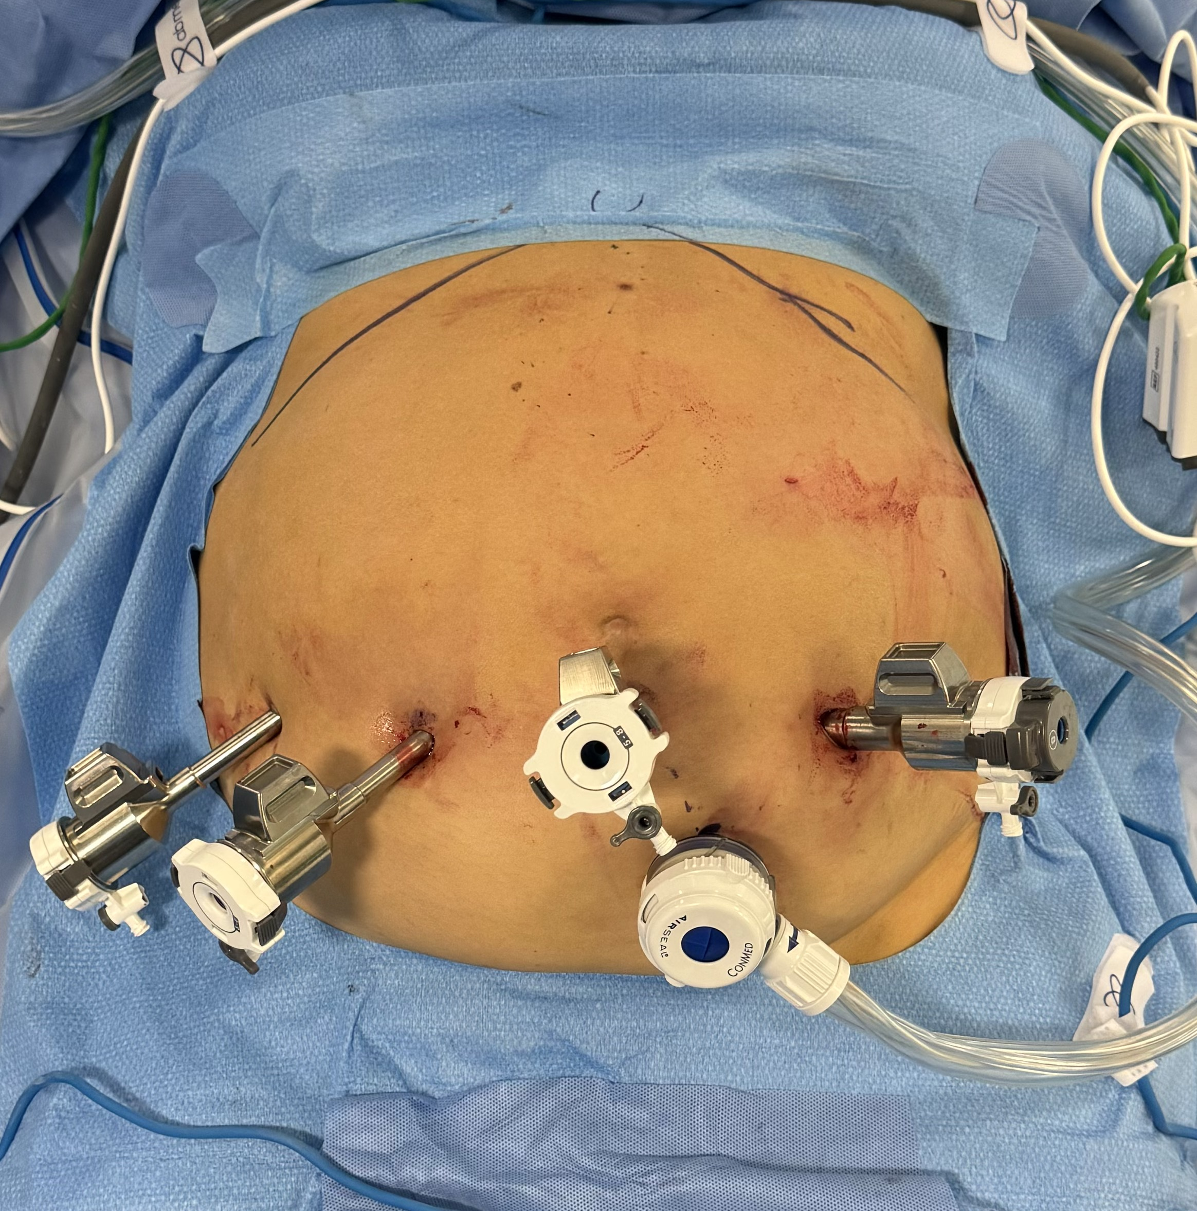
RSG: How we do it
Trocars placement and docking
Targeting
Dissection of the greater curvature
36FR Bougie
Vertical gastrectomy
Methylene-blue test
Abdominal Drain

Slide 9
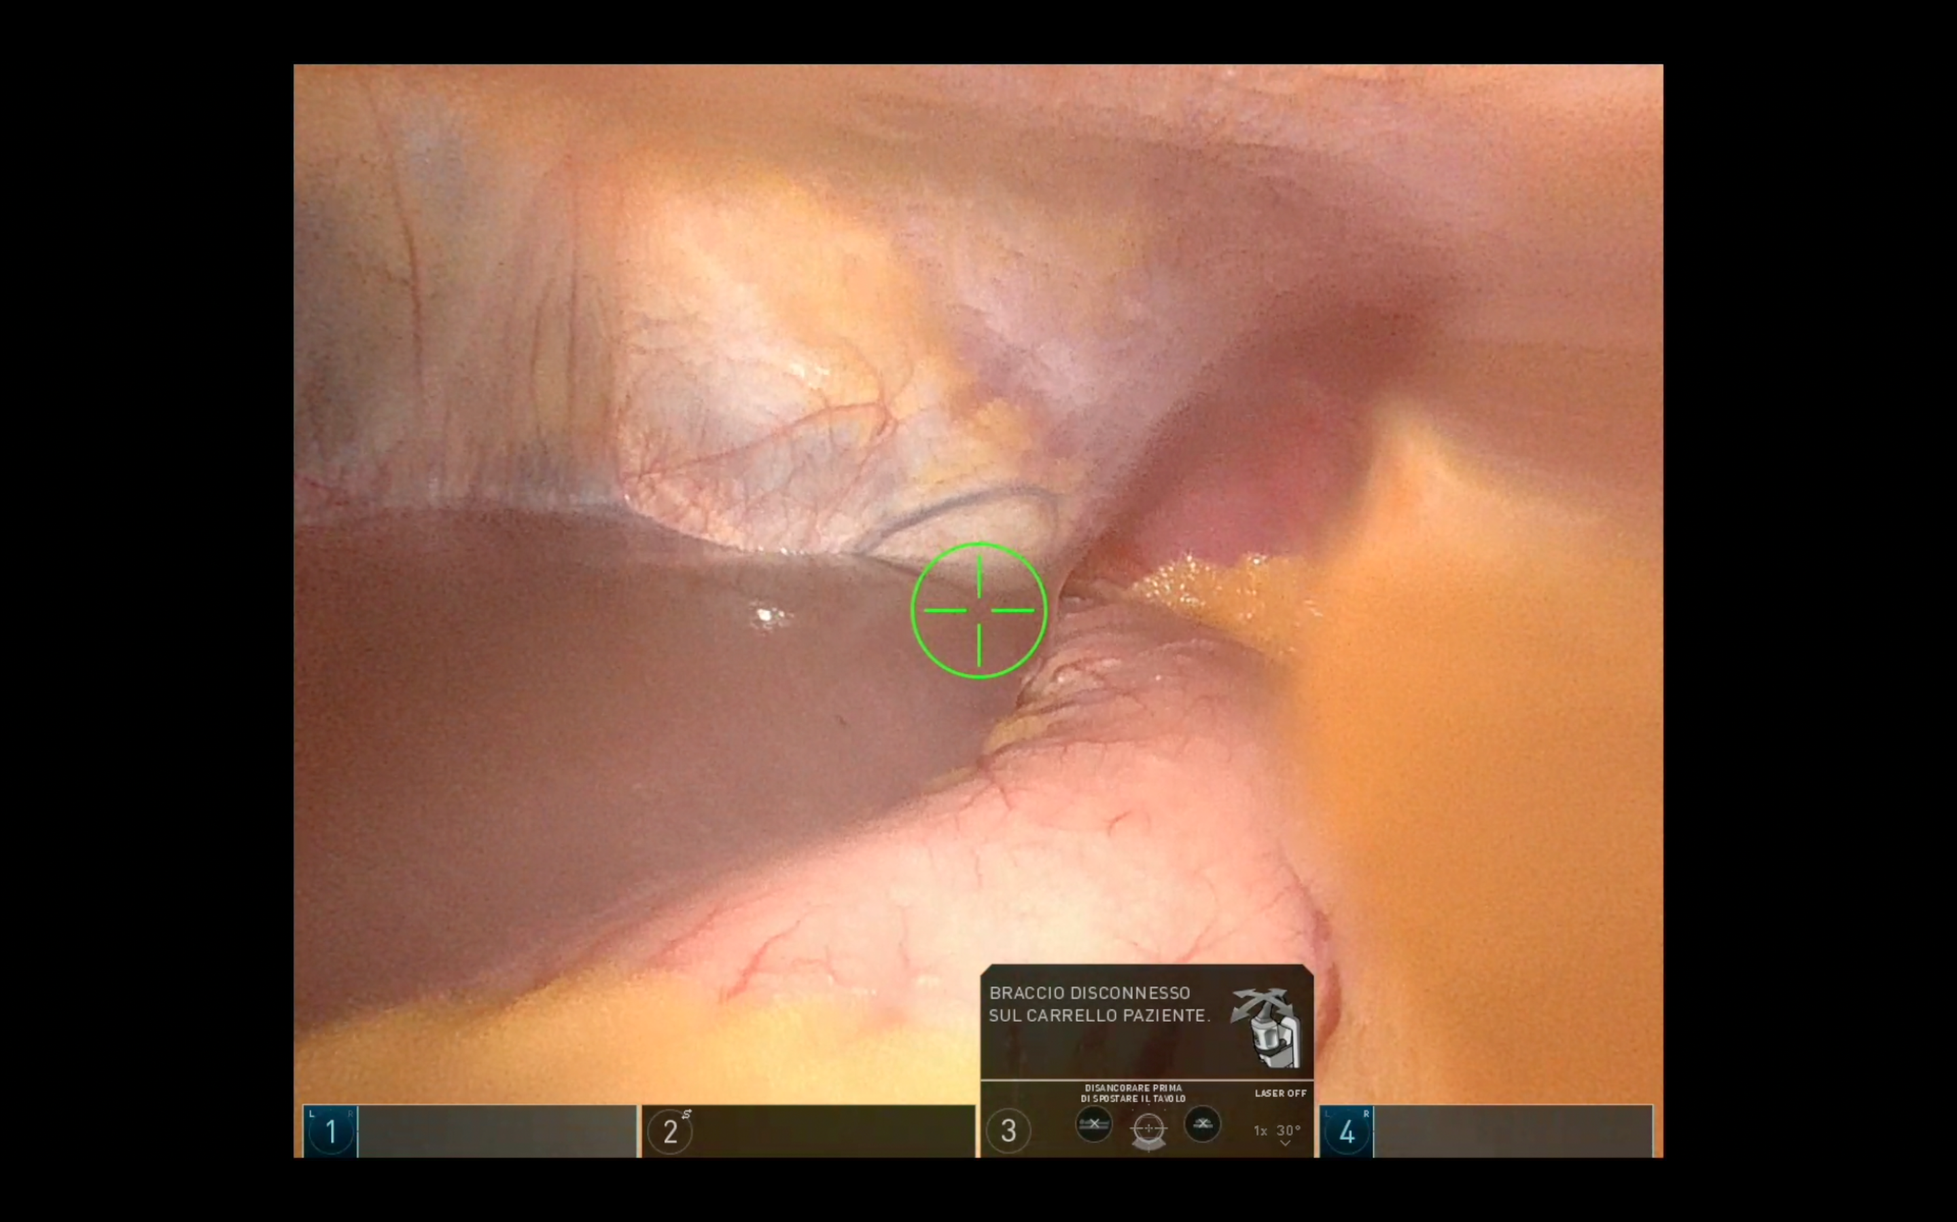
RSG: How we do it
Trocars placement and docking
Targeting
Dissection of the greater curvature
36FR Bougie
Vertical gastrectomy
Methylene-blue test
Abdominal Drain

Slide 10
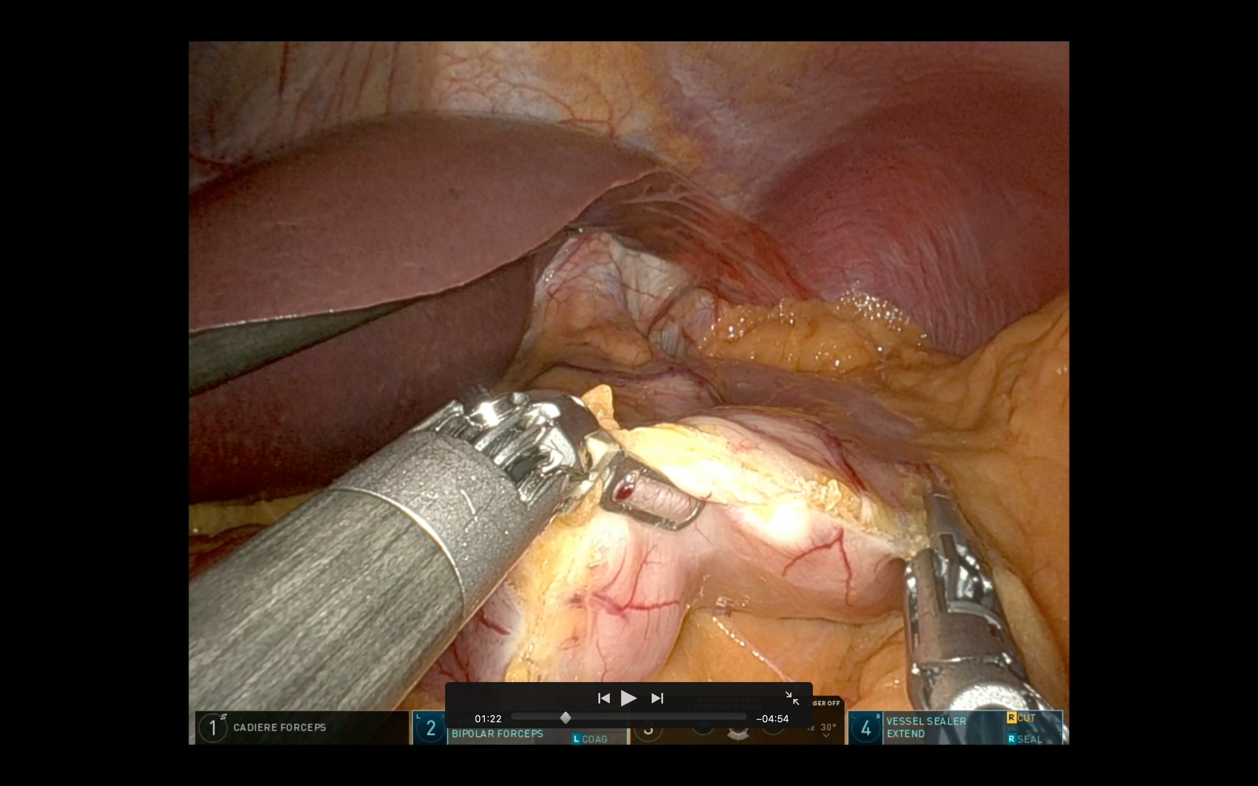
RSG: How we do it
Trocars placement and docking
Targeting
Dissection of the greater curvature
36FR Bougie
Vertical gastrectomy
Methylene-blue test
Abdominal Drain

Slide 11
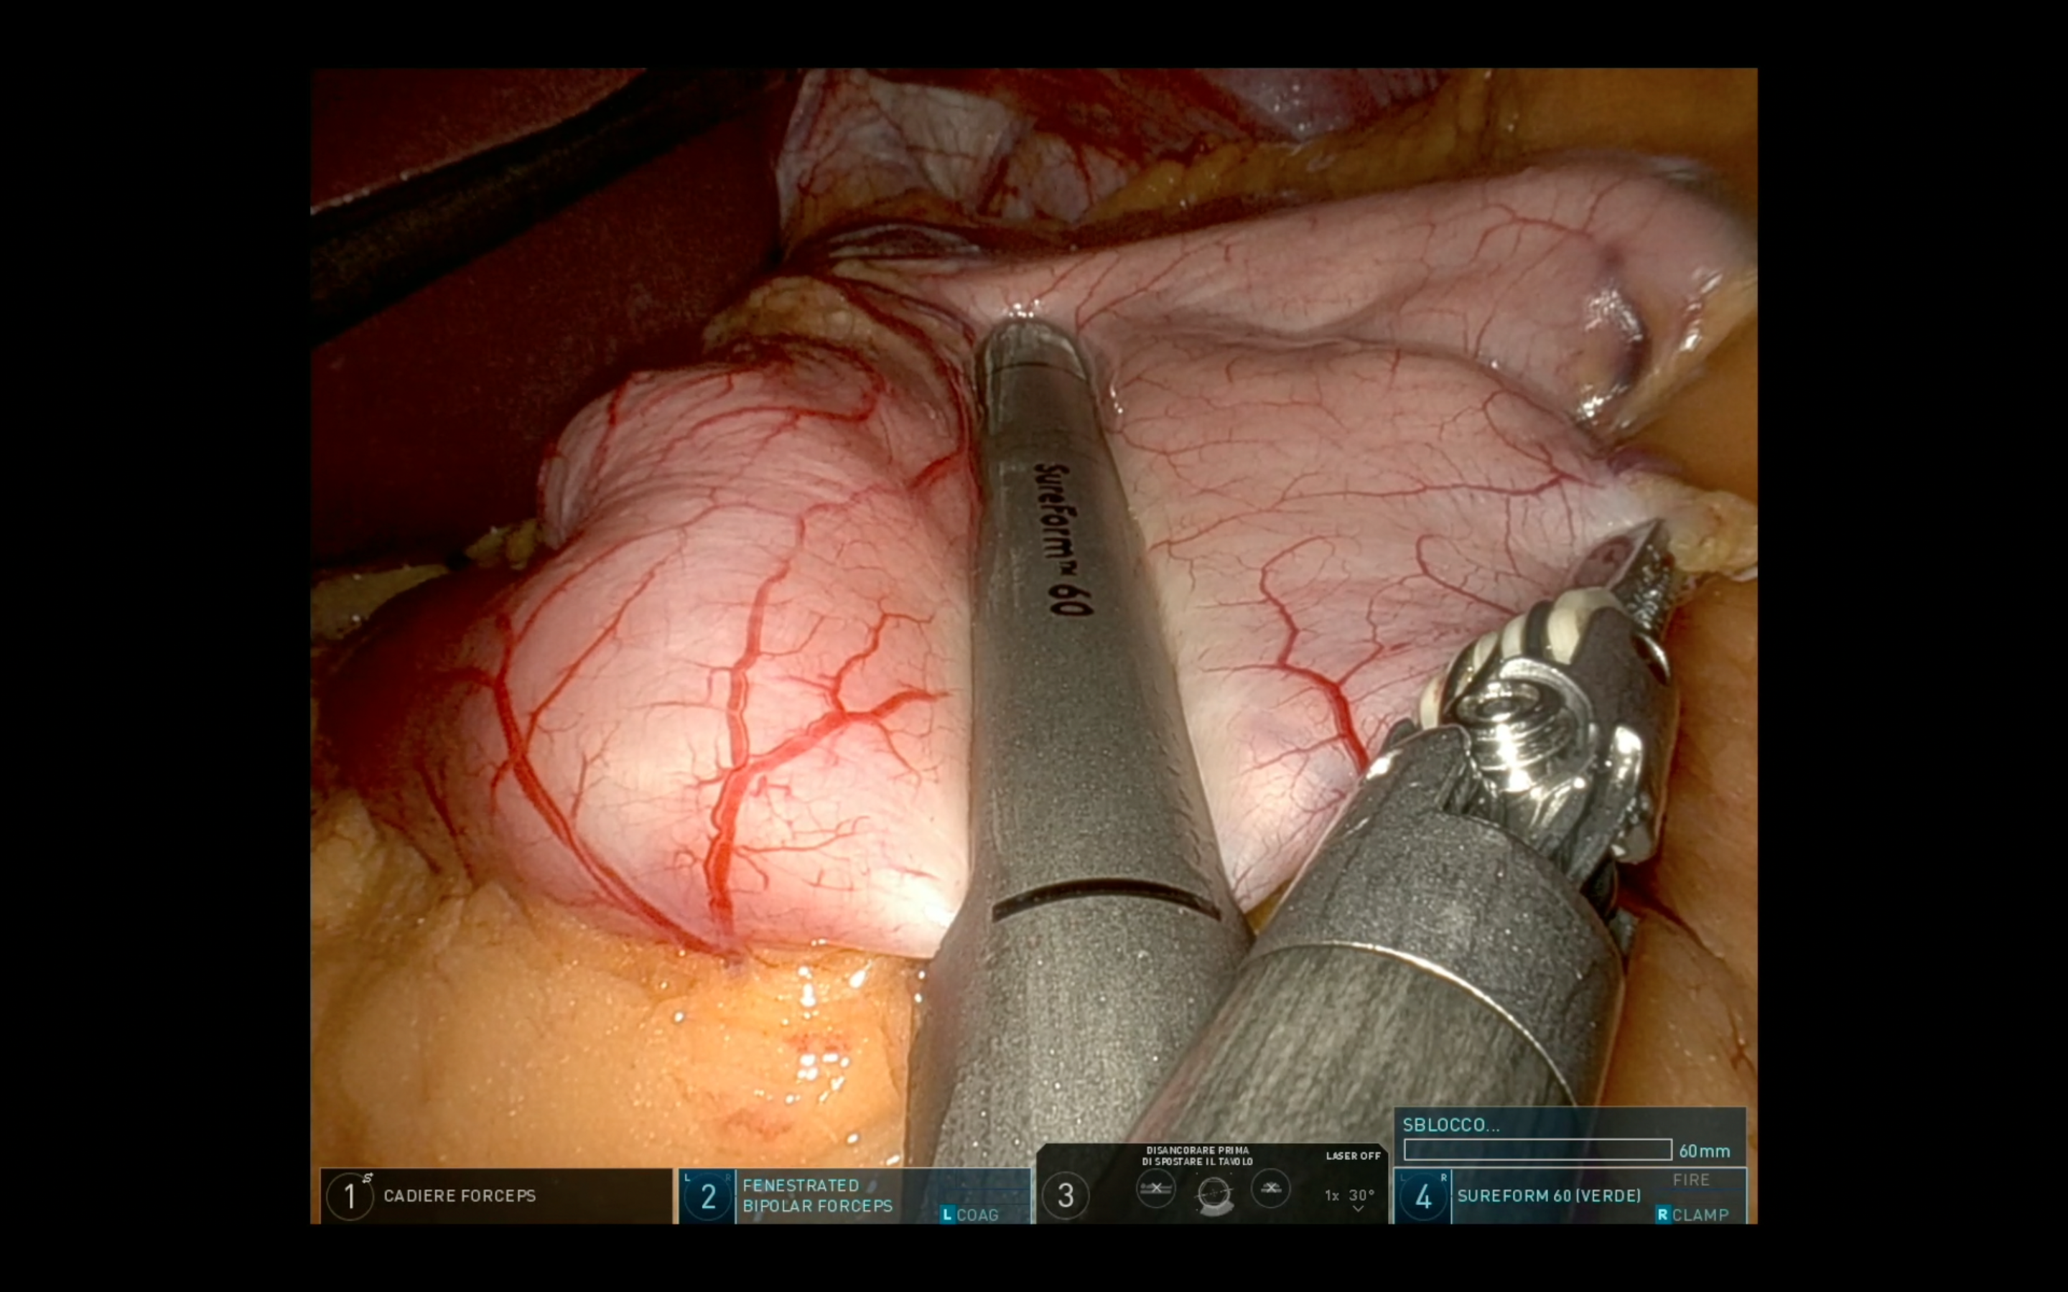
RSG: How we do it
Trocars placement and docking
Targeting
Dissection of the greater curvature
36FR Bougie
Vertical gastrectomy
Methylene-blue test
Abdominal Drain

Slide 12
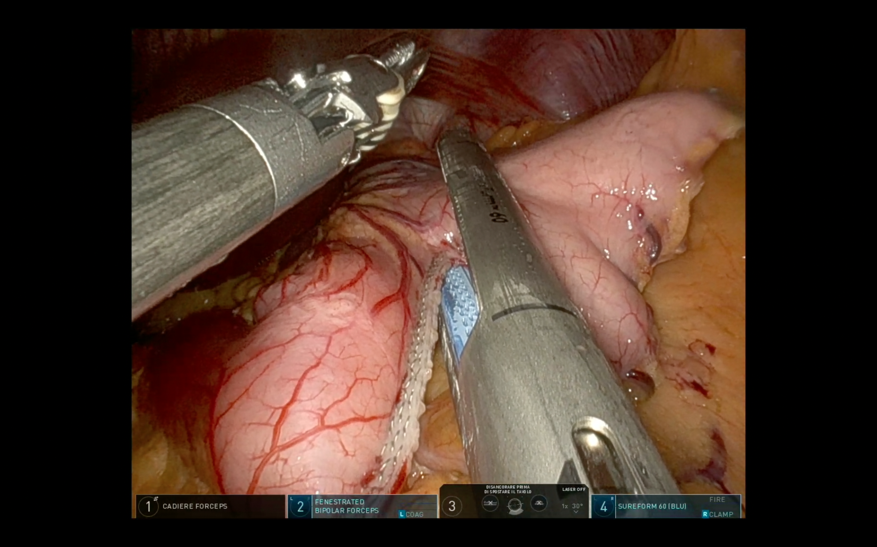
RSG: How we do it
Trocars placement and docking
Targeting
Dissection of the greater curvature
36FR Bougie
Vertical gastrectomy
Methylene-blue test
Abdominal Drain

Slide 13
Methods
The study was a non-randomized retrospective review of 64 patients treated at the “AOU Policlinico Federico II Advanced Biomedical Sciences Department - Federico II University
Data from our first RSG experiences were retrospectively collected from July 2021 trought December 2023
Such data were compared with LSG performed trought same period
The study included 32 RSG (Da Vinci Xi surgical system®) vs 32 LSG
Demographic data, duration of surgery, conversion rate, postoperative pain, loss rate, postoperative morbidity and mortality, and length of hospital stay were examined.
A cost analysis was not conducted.

Slide 14
Results
The mean age of patients was 38 years
40 female, 24 male
The preoperative BMI of patients was slightly higher, for patients treated by laparoscopy
The duration of surgery was longer in the RSG group influenced by the docking time
One RSG patient had to be converted to standard laparoscopy
PONV scale showed no significant differences
VAS scale, was slightly increased on POD1 for robotic patients.
One LSG patient had abdominal wall bleeding
LOS showed no differences

Slide 15
Results
DOCKING TIME (MINUTES)
The mean age of patients was 38 years
40 female, 24 male
The preoperative BMI of patients was slightly higher, for patients treated by laparoscopy
The duration of surgery was longer in the RSG group influenced by the docking time
One RSG patient had to be converted to standard laparoscopy
PONV scale showed no significant differences
VAS scale, was slightly increased on POD1 for robotic patients
One LSG patient had abdominal wall bleeding.
LOS showed no differences
14,06

Slide 16
Results
The mean age of patients was 38 years
40 female, 24 male
The preoperative BMI of patients was slightly higher, for patients treated by laparoscopy
The duration of surgery was longer in the RSG group influenced by the docking time
One RSG patient had to be converted to standard laparoscopy
PONV scale showed no significant differences
VAS scale, was slightly increased on POD1 for robotic patients.
One LSG patient had abdominal wall bleeding
LOS showed no differences

Slide 17
Single surgeon unpublished experience – Dr. Mario Musella: Surgeon's own da Vinci and lap data Bariatric Sleeve
CLINICAL OUTCOMES WITH ESTIMATED COST SAVINGS
Age
BMI
(kg/m2)
Length of Stay
(Days)
Operative Time
(Minutes)
Blood Transfusions
(%)
15,5
Lap
Da Vinci RAS
€600
€24
€128
(per bed day)
(per minute)
(per transfusion)
Cost
Potential savings with da Vinci RAS per procedure: results from cost modeling
Estimated Cost Savings Per Procedure
Estimated Total Cost Savings
€153 vs. Lap
€2,911 vs. Lap
Dr. Mario Musella provided data for Bariatric Sleeve, da Vinci: 06/2021 - 12/2023, Lap: 3/2023 - 12/2023. Outcome measures reported in this presentation are selected based on the surgeon’s interests and availability of relevant data. The surgeon provided estimated cost for Length of Stay, Operative Time, Blood Transfusions.
Data presented for robotic-assisted surgery reflect a single surgeon experience (data is not collected under formalized study. DATA IS NOT PEER REVIEWED AND NOT PUBLISHED) that may or may not be reproducible and is not generalizable. This data comparison is not case matched for patient complexity and/or disease status and may not be comparable across these surgical modalities. As such, this data presentation should be considered as informational only and is not conclusive. Cost estimates have been independently generated by Intuitive Surgical using cost modeling methodology based on national averages and have not been published or peer-reviewed.

Slide 18
Conclusions
RSG is a safe alternative to LSG
Comparable clinical outcomes
RSG has longer surgery times
It is essential to work with a skilled team on robotic platforms
RSG has higher postoperative pain
RSG represents a promising procedure for gaining proficiency with robotic platforms.
It is essential to identify procedures and types of patients who would benefit most from robotic surgery, both clinically and economically.

Slide 19
Grazie per l’attenzione
antoniofranzese@hotmail.it

